Slide 1
ANLY 506-90 Exploratory Data Analysis FINAL PRESENTATION
Team #3 Members: Alyson Stone, Dinesh Kale, Jiwen Li, Shani Bird,
Sri Sai Koteswara Kadiyala, Vinod Basalalli, Xiaowan Ouyang

Slide 2
AGENDA
Research Goal
Background
Data Set
Preliminary Exploration
Independent Variable
Dependent Variables
Technical Approach
Variables Analyzed
Analysis
Model Selection
Test & Evaluation
Conclusion

Slide 3
Research Goal
Project explores the demographics of people living in areas with high violent crime rates compared to the United States average crime rate.
Purpose: Determine whether certain demographic characteristics are correlated with violent crime rates.
Communities and Crime Un-normalized Data Set used Exploratory Data Analysis to conduct Linear Regression Analysis
evaluating crime rates to find cities with high violent crime
test for a positive correlation with violent crime rates.

Slide 4
Background & Issue
Crime is a social entity that disrupts normalcy in a civil setting
Growing Concern over increasing Crime Rate affects the economic activity as well as quality of life
Researchers have been studying data related to crime rates and discovered socio-economic variables are the main factors of crime rate
Including level of poverty, marital status, unemployment rate, ethnicity, drug abuse, youth education

Slide 5
The Problem
The Big Question?
What is the background of individuals involved in violent crimes in areas of the United States where the crime rate is greater than the national average?
Sub-problems
Which areas have higher crime rates than the national average of violent crimes?
What is the background of individuals based on ethnicity, education, age, income etc., involved in violent crimes in these particular areas?
What other factors play a part in contributing to higher rates of violent crimes in the most violent areas of the United States?

Slide 6
Data Set: Preliminary Exploration
Communities and Crime Unnormalized Data Set (http://mlr.cs.umass.edu/ml/datasets/Communities+and+Crime+Unnormalized )
147 attributes and 2215 instances/observations
March 2, 2011
Required pre-processing prior to data mining
Main elements
Population
Ethnicity
Age
income
education

Slide 7
Technical Approach: Variables Analyzed
Communityname: Community name
racepctblack: percentage of population that is african american
racePctWhite: percentage of population that is caucasian
racePctAsian: percentage of population that is of asian heritage
racePctHisp: percentage of population that is of hispanic heritage
agePct12t21: percentage of population that is 12-21 in age (REJECTED BECAUSE agePct12t29 would account for this)
agePct12t29: percentage of population that is 12-29 in age
agePct16t24: percentage of population that is 16-24 in age (REJECTED BECAUSE agePct12t29 would account for this)
agePct65up: percentage of population that is 65 and over in age
PctPopUnderPov: percentage of people under the poverty level
PctLess9thGrade: percentage of people 25 and over with less than a 9th grade education
PctNotHSGrad: percentage of people 25 and over that are not high school graduates
PctBSorMore: percentage of people 25 and over with a bachelor's degree or higher education
PctUnemployed: percentage of people 16 and over, in the labor force, and unemployed
PolicPerPop: police officers per 100K population
ViolentCrimesPerPop: total number of violent crimes per 100K population (numeric - decimal) GOAL attribute (to be predicted)
nonViolPerPop: total number of non-violent crimes per 100K population (numeric - decimal) potential GOAL attribute (to be predicted)

Slide 8
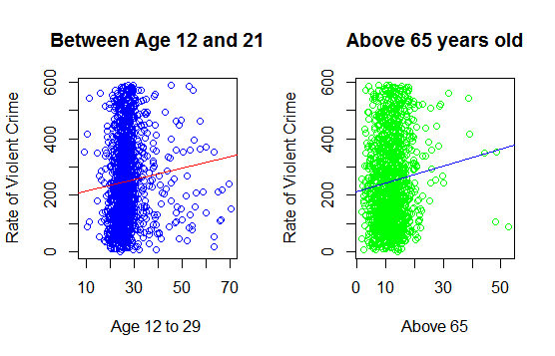
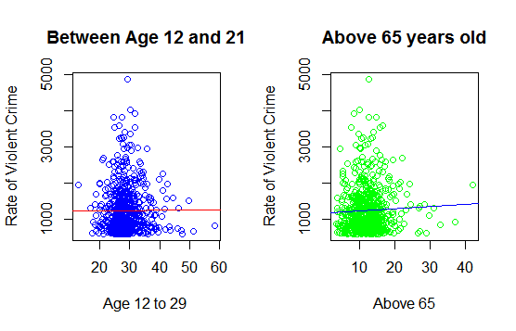
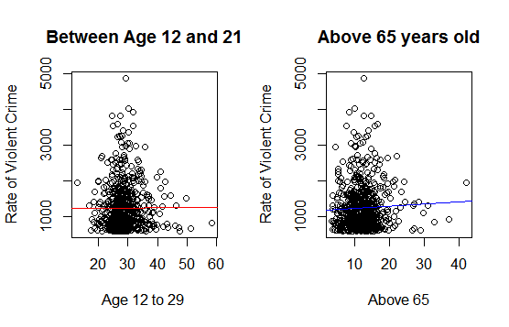
Analysis: Co-relation of Violent Crime with age group
Violent Crime with Age Group for Safest Cities
Violent Crime With Age Group for Violent Areas
Violent Crime with Age Group

Slide 9
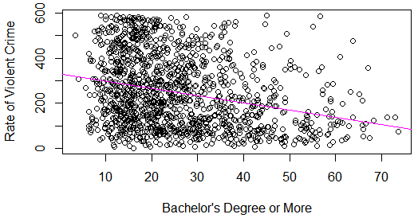
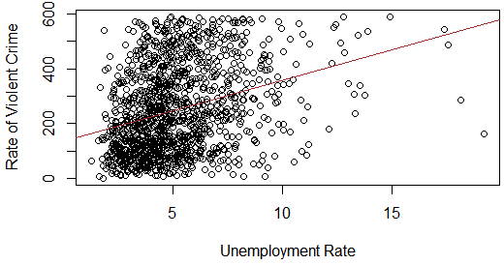
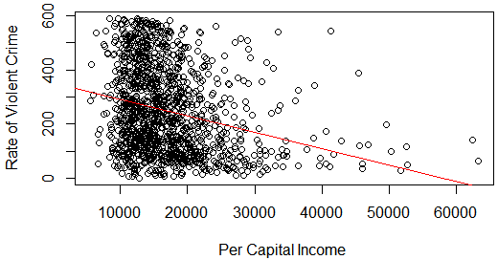
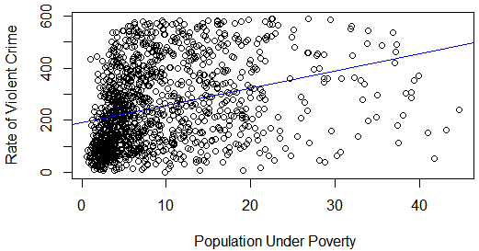
Analysis: Crime Rate in Safest Area
with Bachelors degree or more
with unemployment
with per capita income
with poverty levels

Slide 10
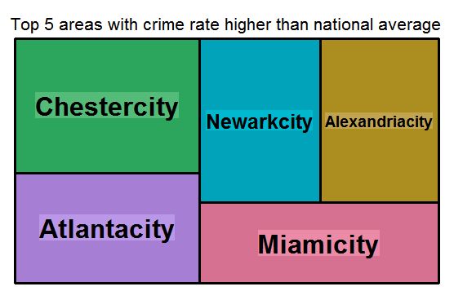
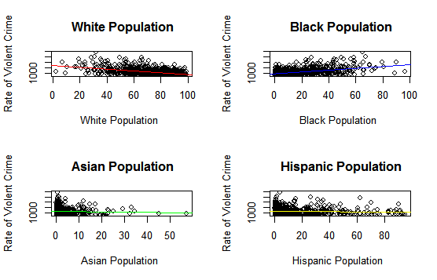
Analysis Summary
Top 5 areas with crime rate higher than national average
High Crime Rates & with Race within Safest Cities

Slide 11
Challenges & Limitation
Co-ordination between team
Time Zones
Work Schedules/Availability
Limited R Coding Experience
Updating Data Set from neighborhood scout website
Cluster the data
Researching for methods to do regression analysis using R
To avoid multi-collinearity focus on feature selection and PCA
Feature to include for an optimal model

Slide 12
Thank you Any Questions?

